Slide 1
End of Program Presentation Player Personnel Neva Williams August 14, 2025

Slide 2

About Me

Slide 3
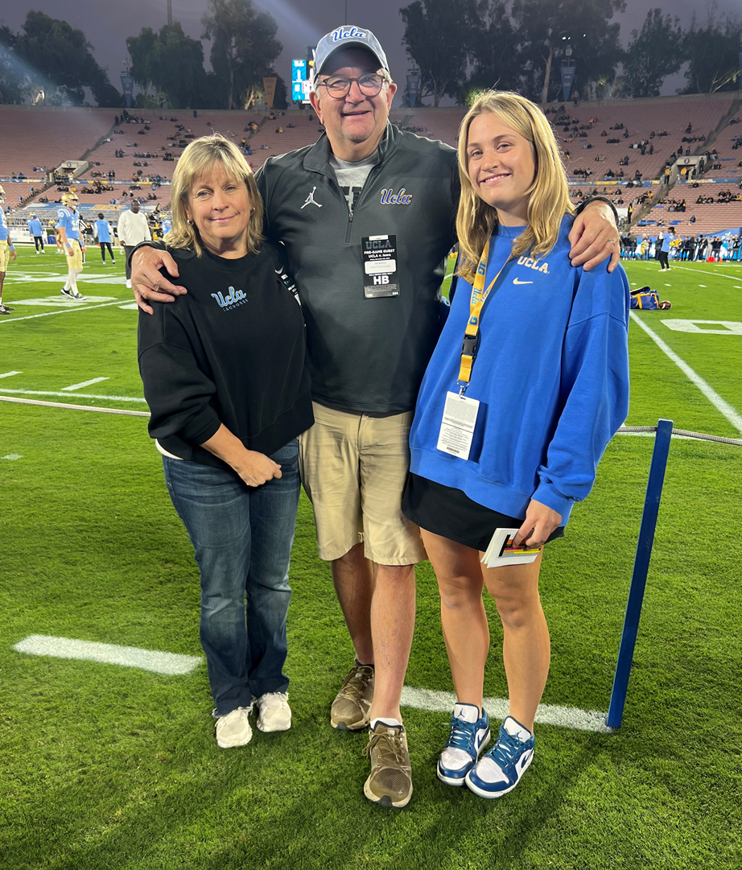
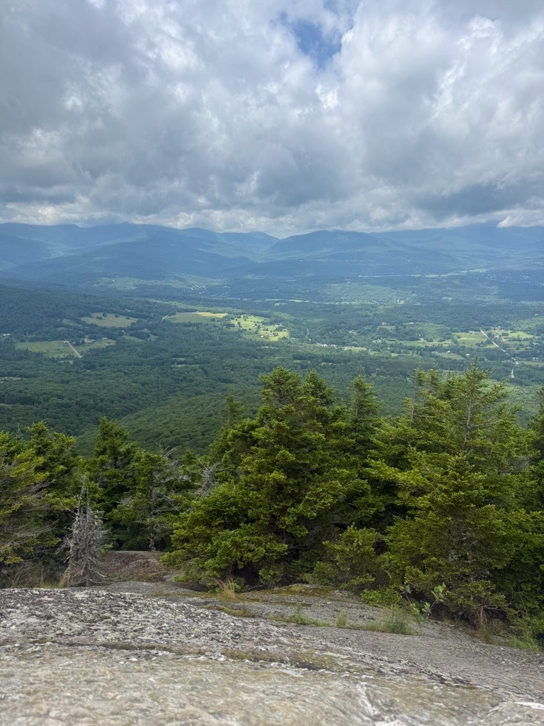



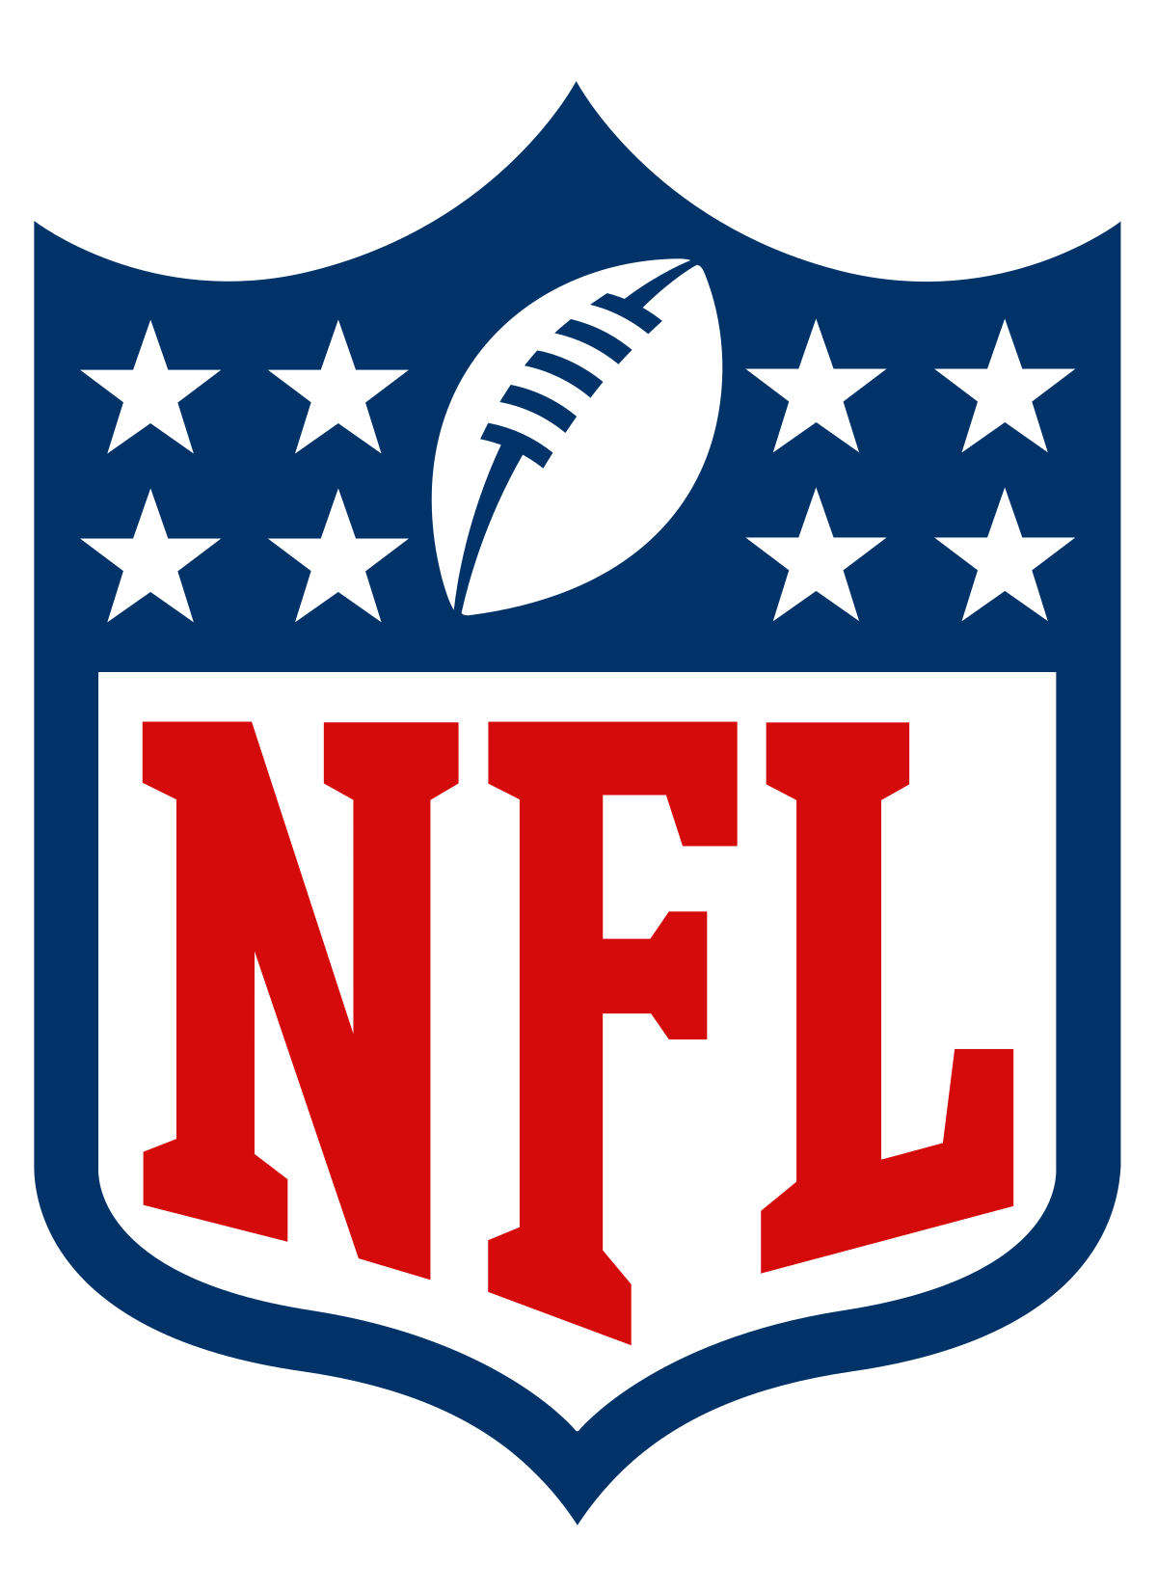
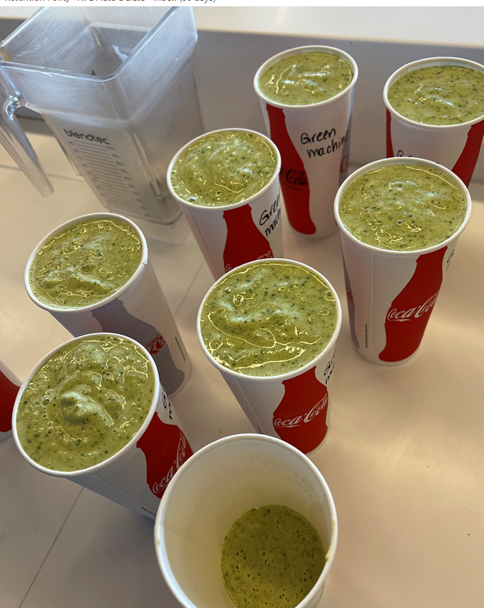
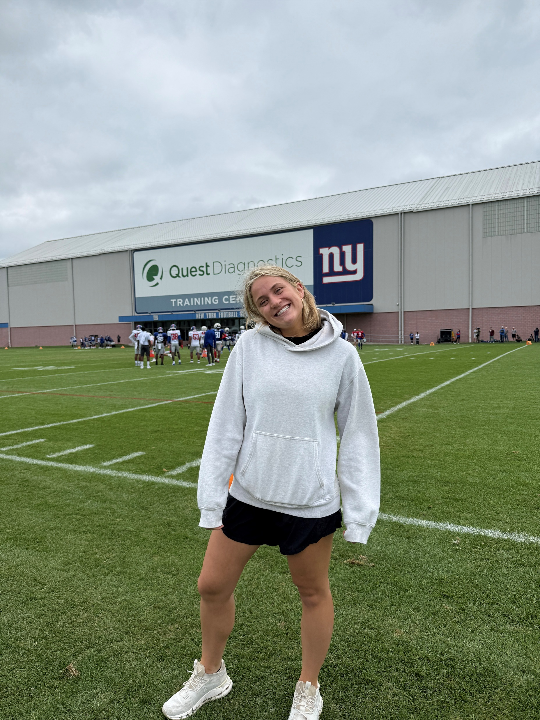


Slide 4
Department Overview

Slide 5
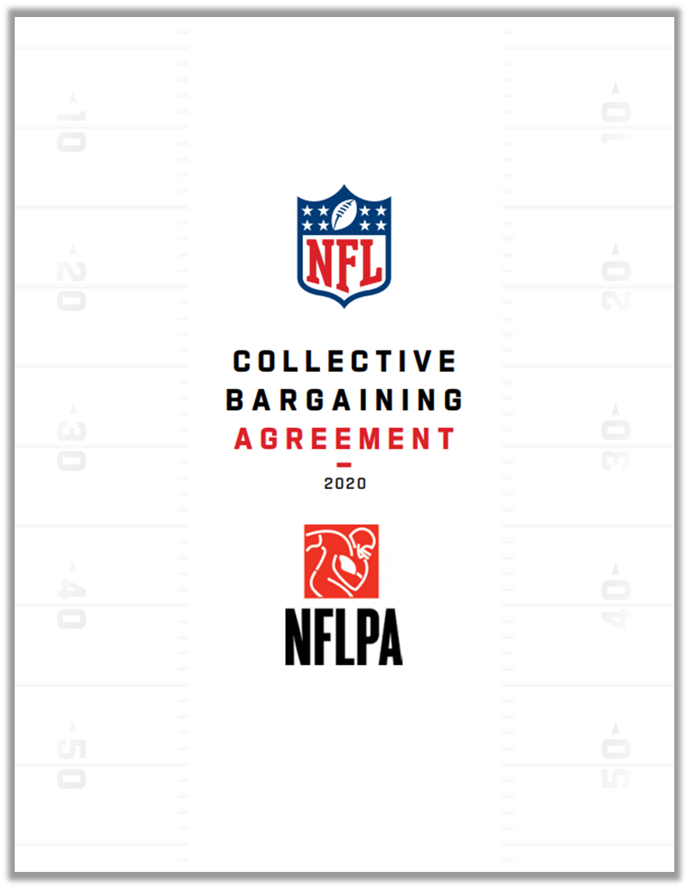
NFL Management Council
The NFL’s multi-employer bargaining unit. It represents the NFL and the member clubs in negotiations with the NFL Players Association regarding all aspects of player working conditions including:
Player Contracts
Roster & Transactions
Compensation & Cap
Benefits
Work Rules
Discipline & Disputes
Player Health and Safety

Slide 6
NFL Management Council
Player Personnel
Labor Operations
Legal Operations
Player Eligibility & Draft
Transactions/Roster Rules
Policies: Anti-Tampering/Injury Report Policy
Non-Player Contracts
Player Finance
Labor Information
Player Contracts
Salary Cap Management
Player Work Rules
Legal Counsel
Labor Policies
Player Benefits/Player Care Foundation

Slide 7
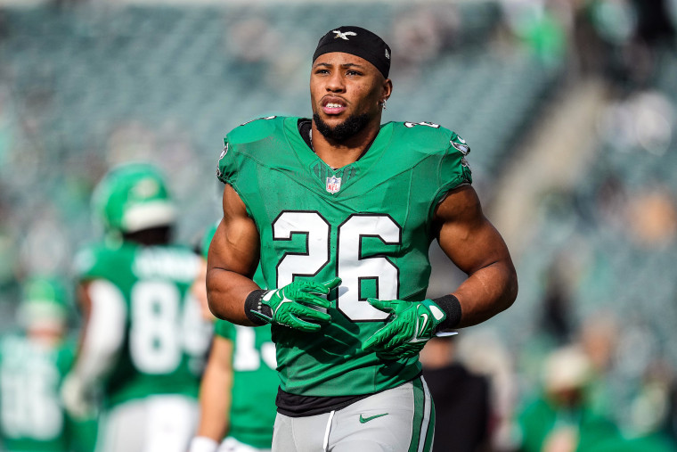
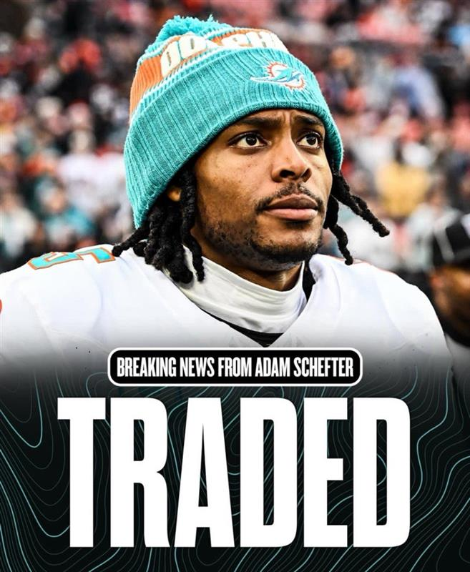
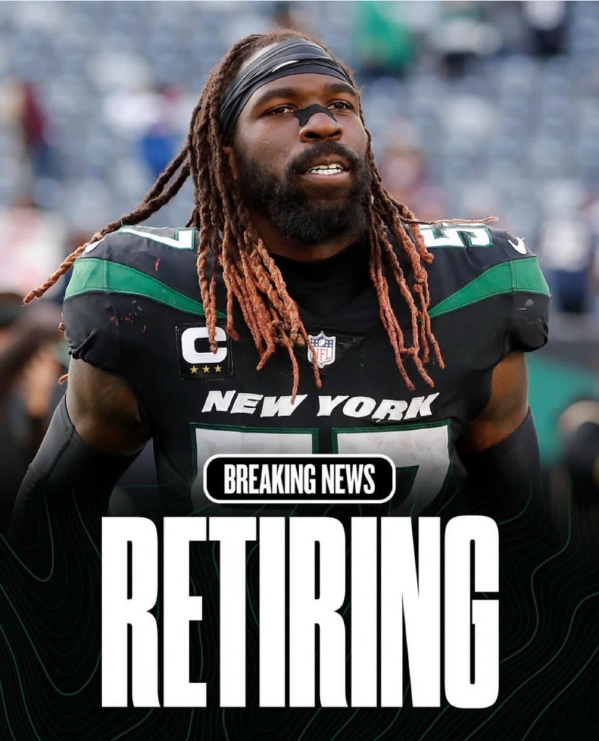
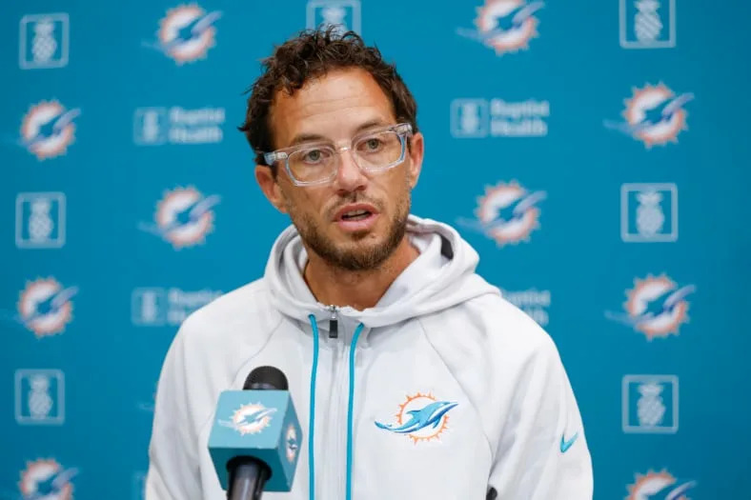
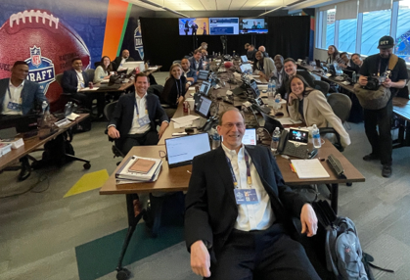
Player Personnel Breakdown
Anti-Tampering / Injury Policies
Transactions/Roster Rules
Non-Player Contracts
Player Eligibility & Draft
Notes:
College Scouting Operations
Ensuring Eligibility
College All-Star Games & Scouting Combine
College Scouting Rules
Draft Operations

Slide 8
My Responsibilities

Slide 9
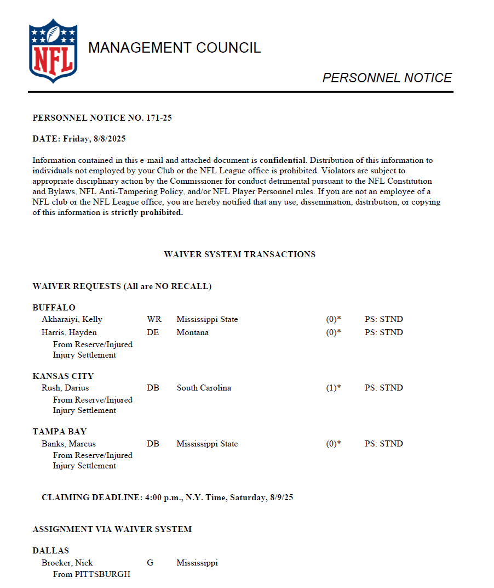
Daily Personnel Notice
The league’s official notification detailing all player transactions, like terminations, trades, waiver awards, and roster status changes
Sent to clubs as the formal record of roster activity every day at 4:00 pm EST

Slide 10
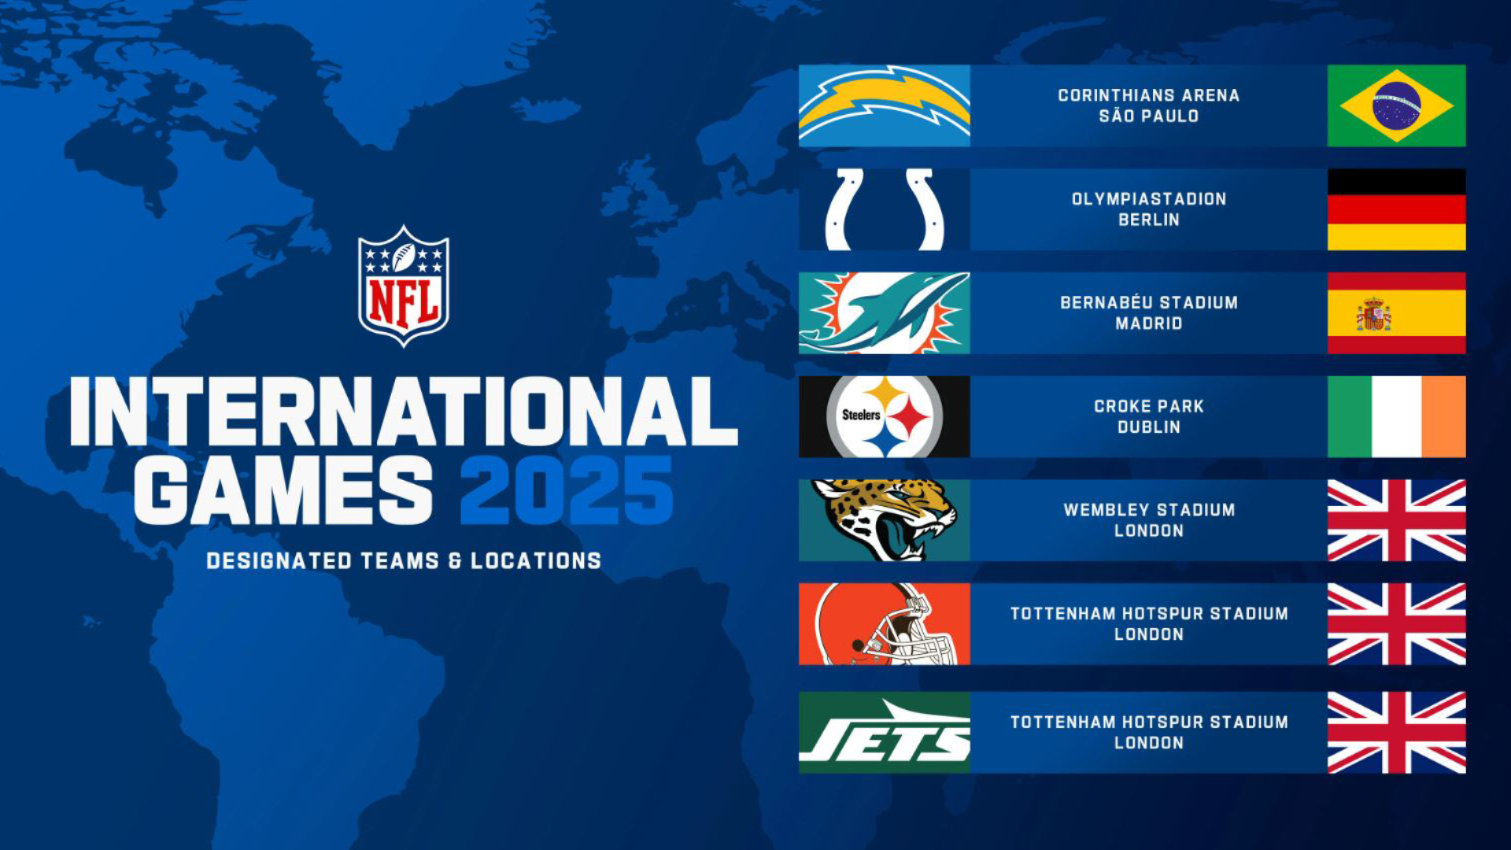
International Player Research
Goal: Give clubs a list of eligible International Practice Squad players to aid in scouting
Process: Reviewed rosters of all 566 NCAA teams (FBS, FCS, D2, D3) using International Practice Squad criteria.
Eligibility: Outside U.S./Canada, ≤2 yrs U.S. HS, prior draft eligible, meets NFL rules.
Roster Rule: Practice Squad may expand to 16 to 17 with one qualifying IP
Cap: PS–International salaries excluded from Salary Cap.

Slide 11
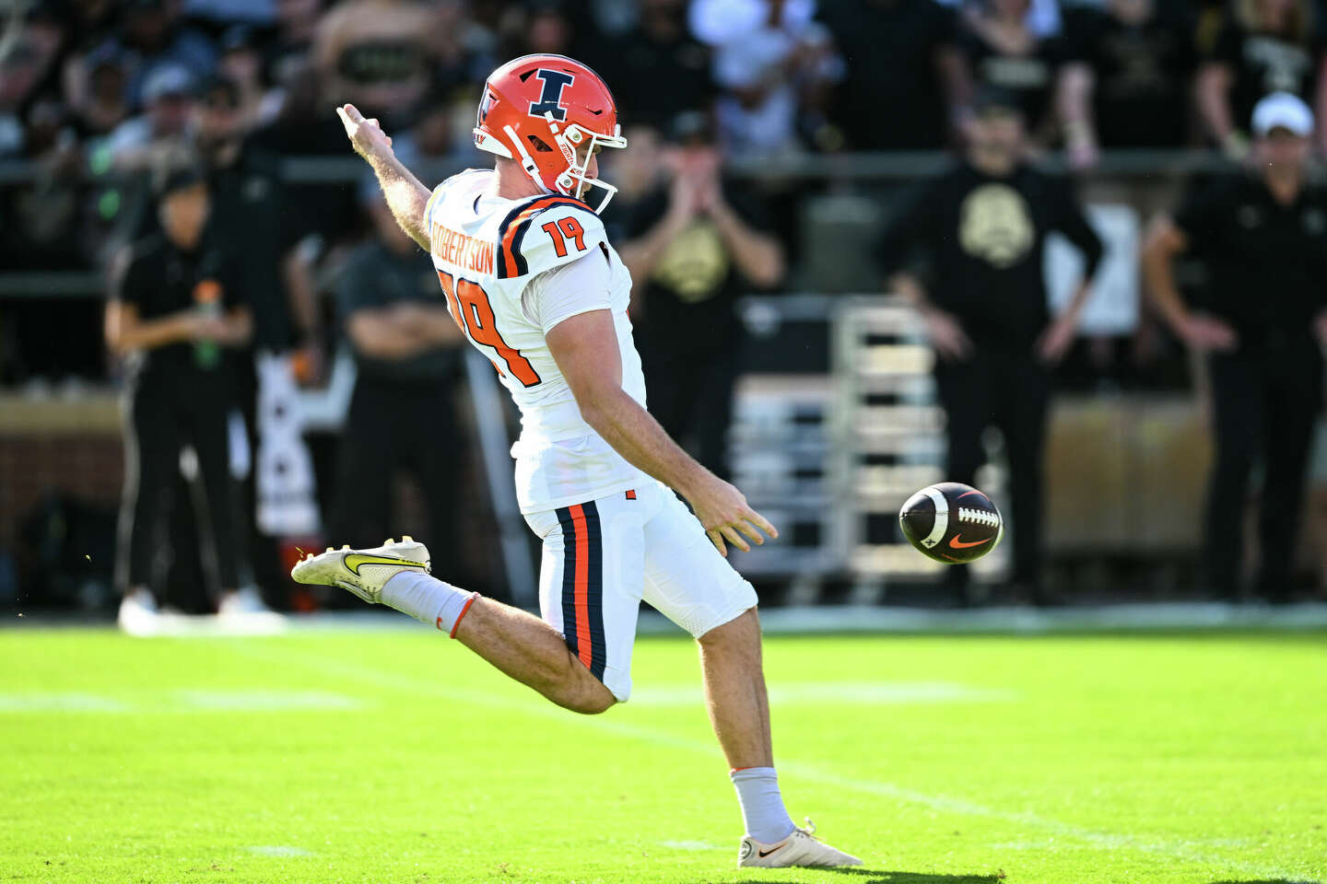

International Player Research
Country trends:
Australia dominates, mainly specialists (punters/kickers).
Germany, American Samoa, and England follow (mostly linemen and TEs.)
Smaller groups from Ireland, Sweden, France, Japan, Nigeria, and others.
Positional trends:
Specialists are largest group, then OL/DL/DE/DT.
Few RB, WR, DB — skill spots are rare internationally.

Slide 12
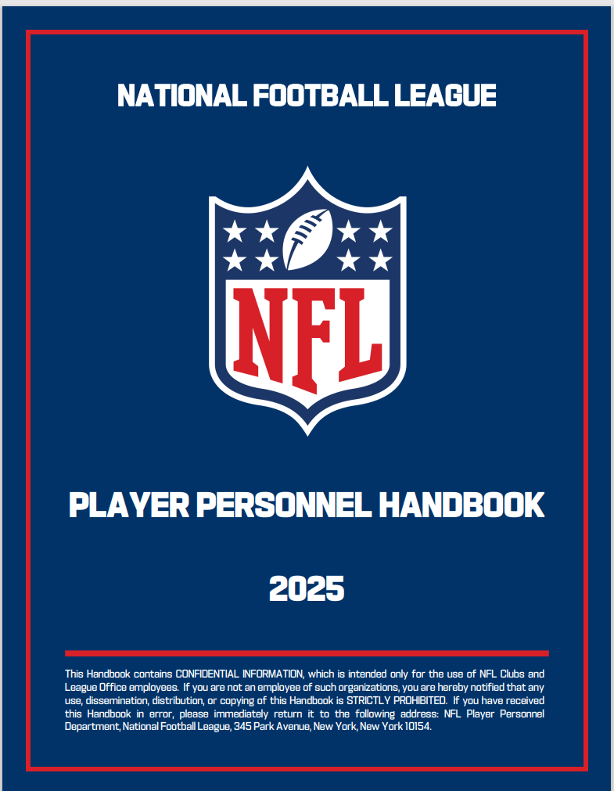
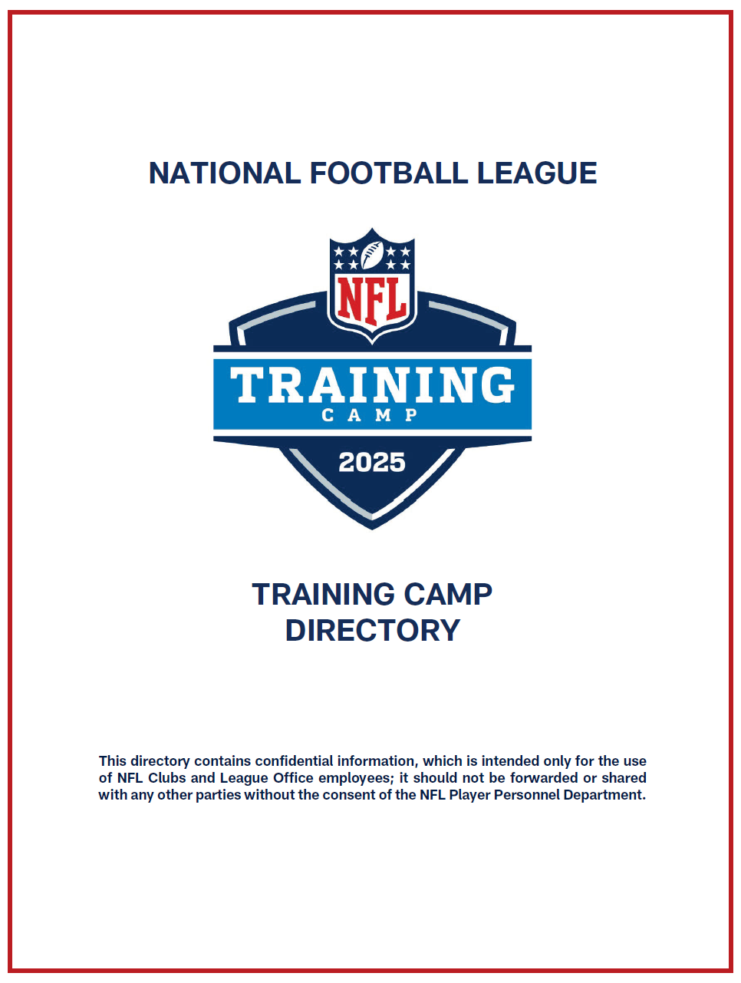
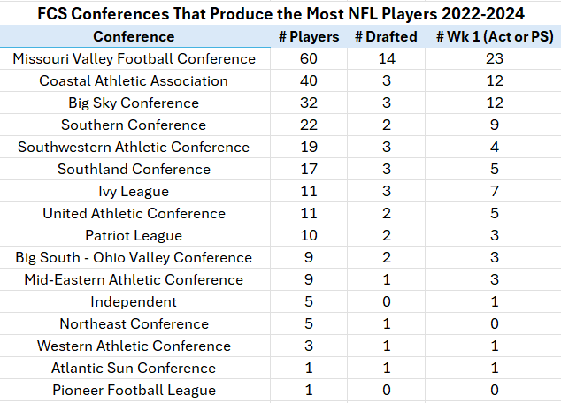
Additional Projects
Coordinated with all 32 teams to create 2025 Training Camp Directory.
Proofread & edited 2025 Player Personnel Handbook.
Researched FCS player prevalence in the NFL
Managed NFL College Relations site updates with school liaisons.
Cleaned master file of all NFL draft picks in history.
Researched guarantee default language in rookie contracts
Updated team conference affiliations on FIS.
Filed past tenders and trade documents.

Slide 13
Key Takeaways

Slide 14
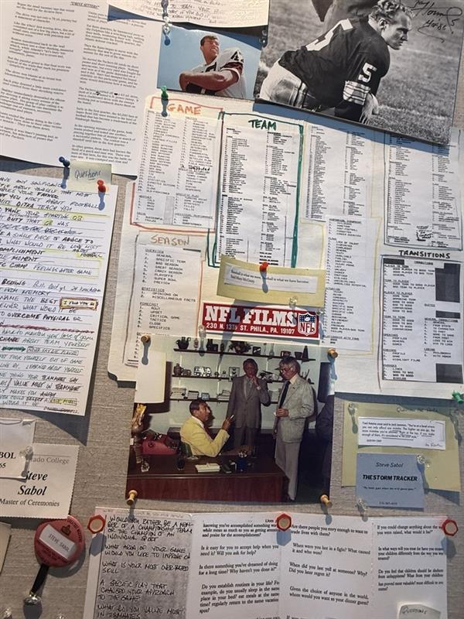
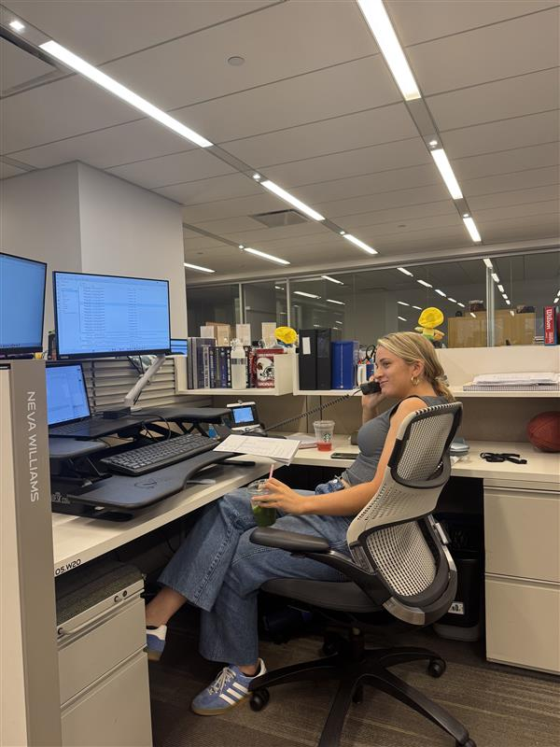
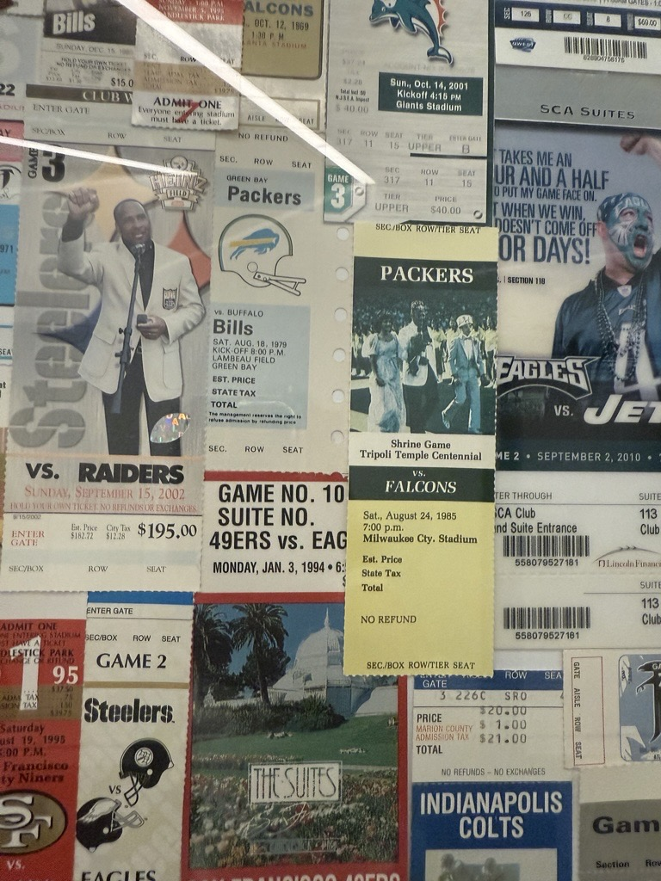
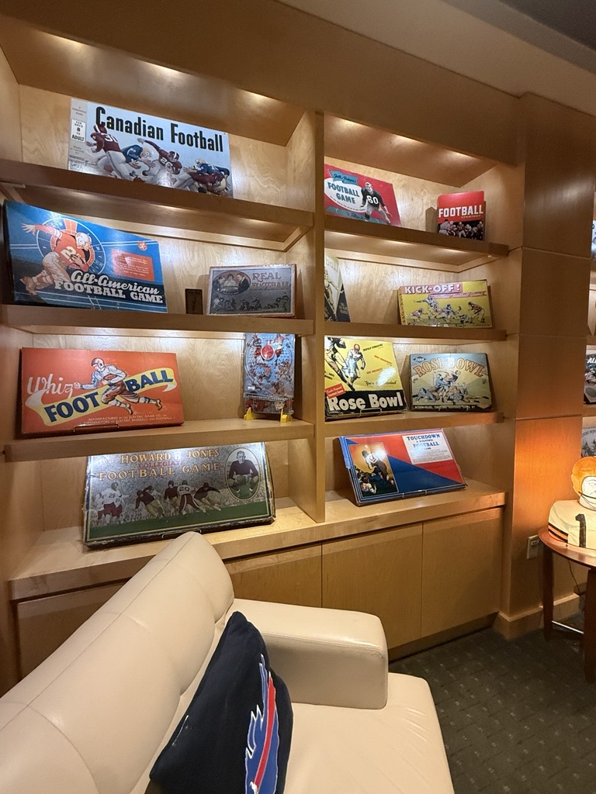
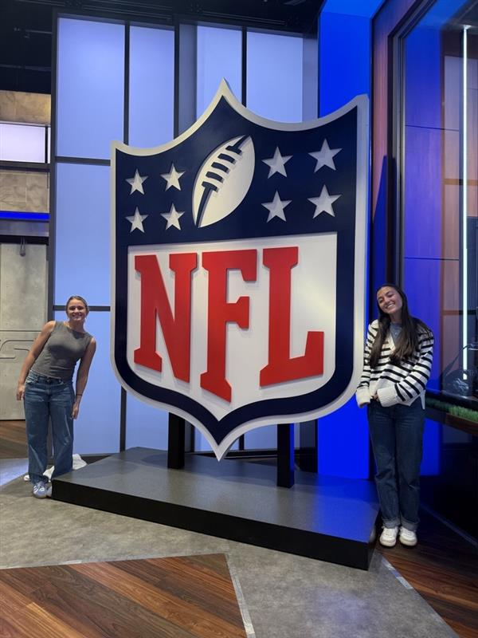
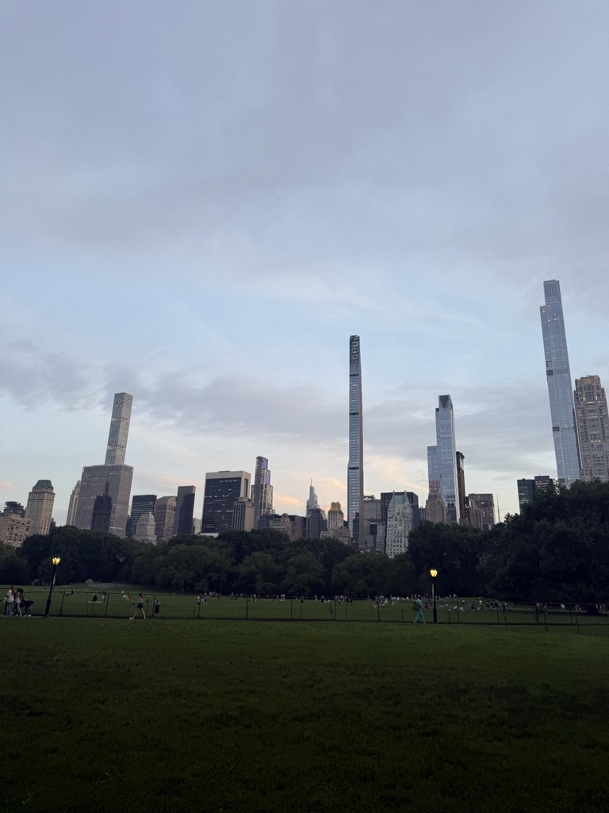
Takeaways
Invest in Relationships
Communication Skills are Crucial
Every Detail Matters
Never Stop Learning

Slide 15
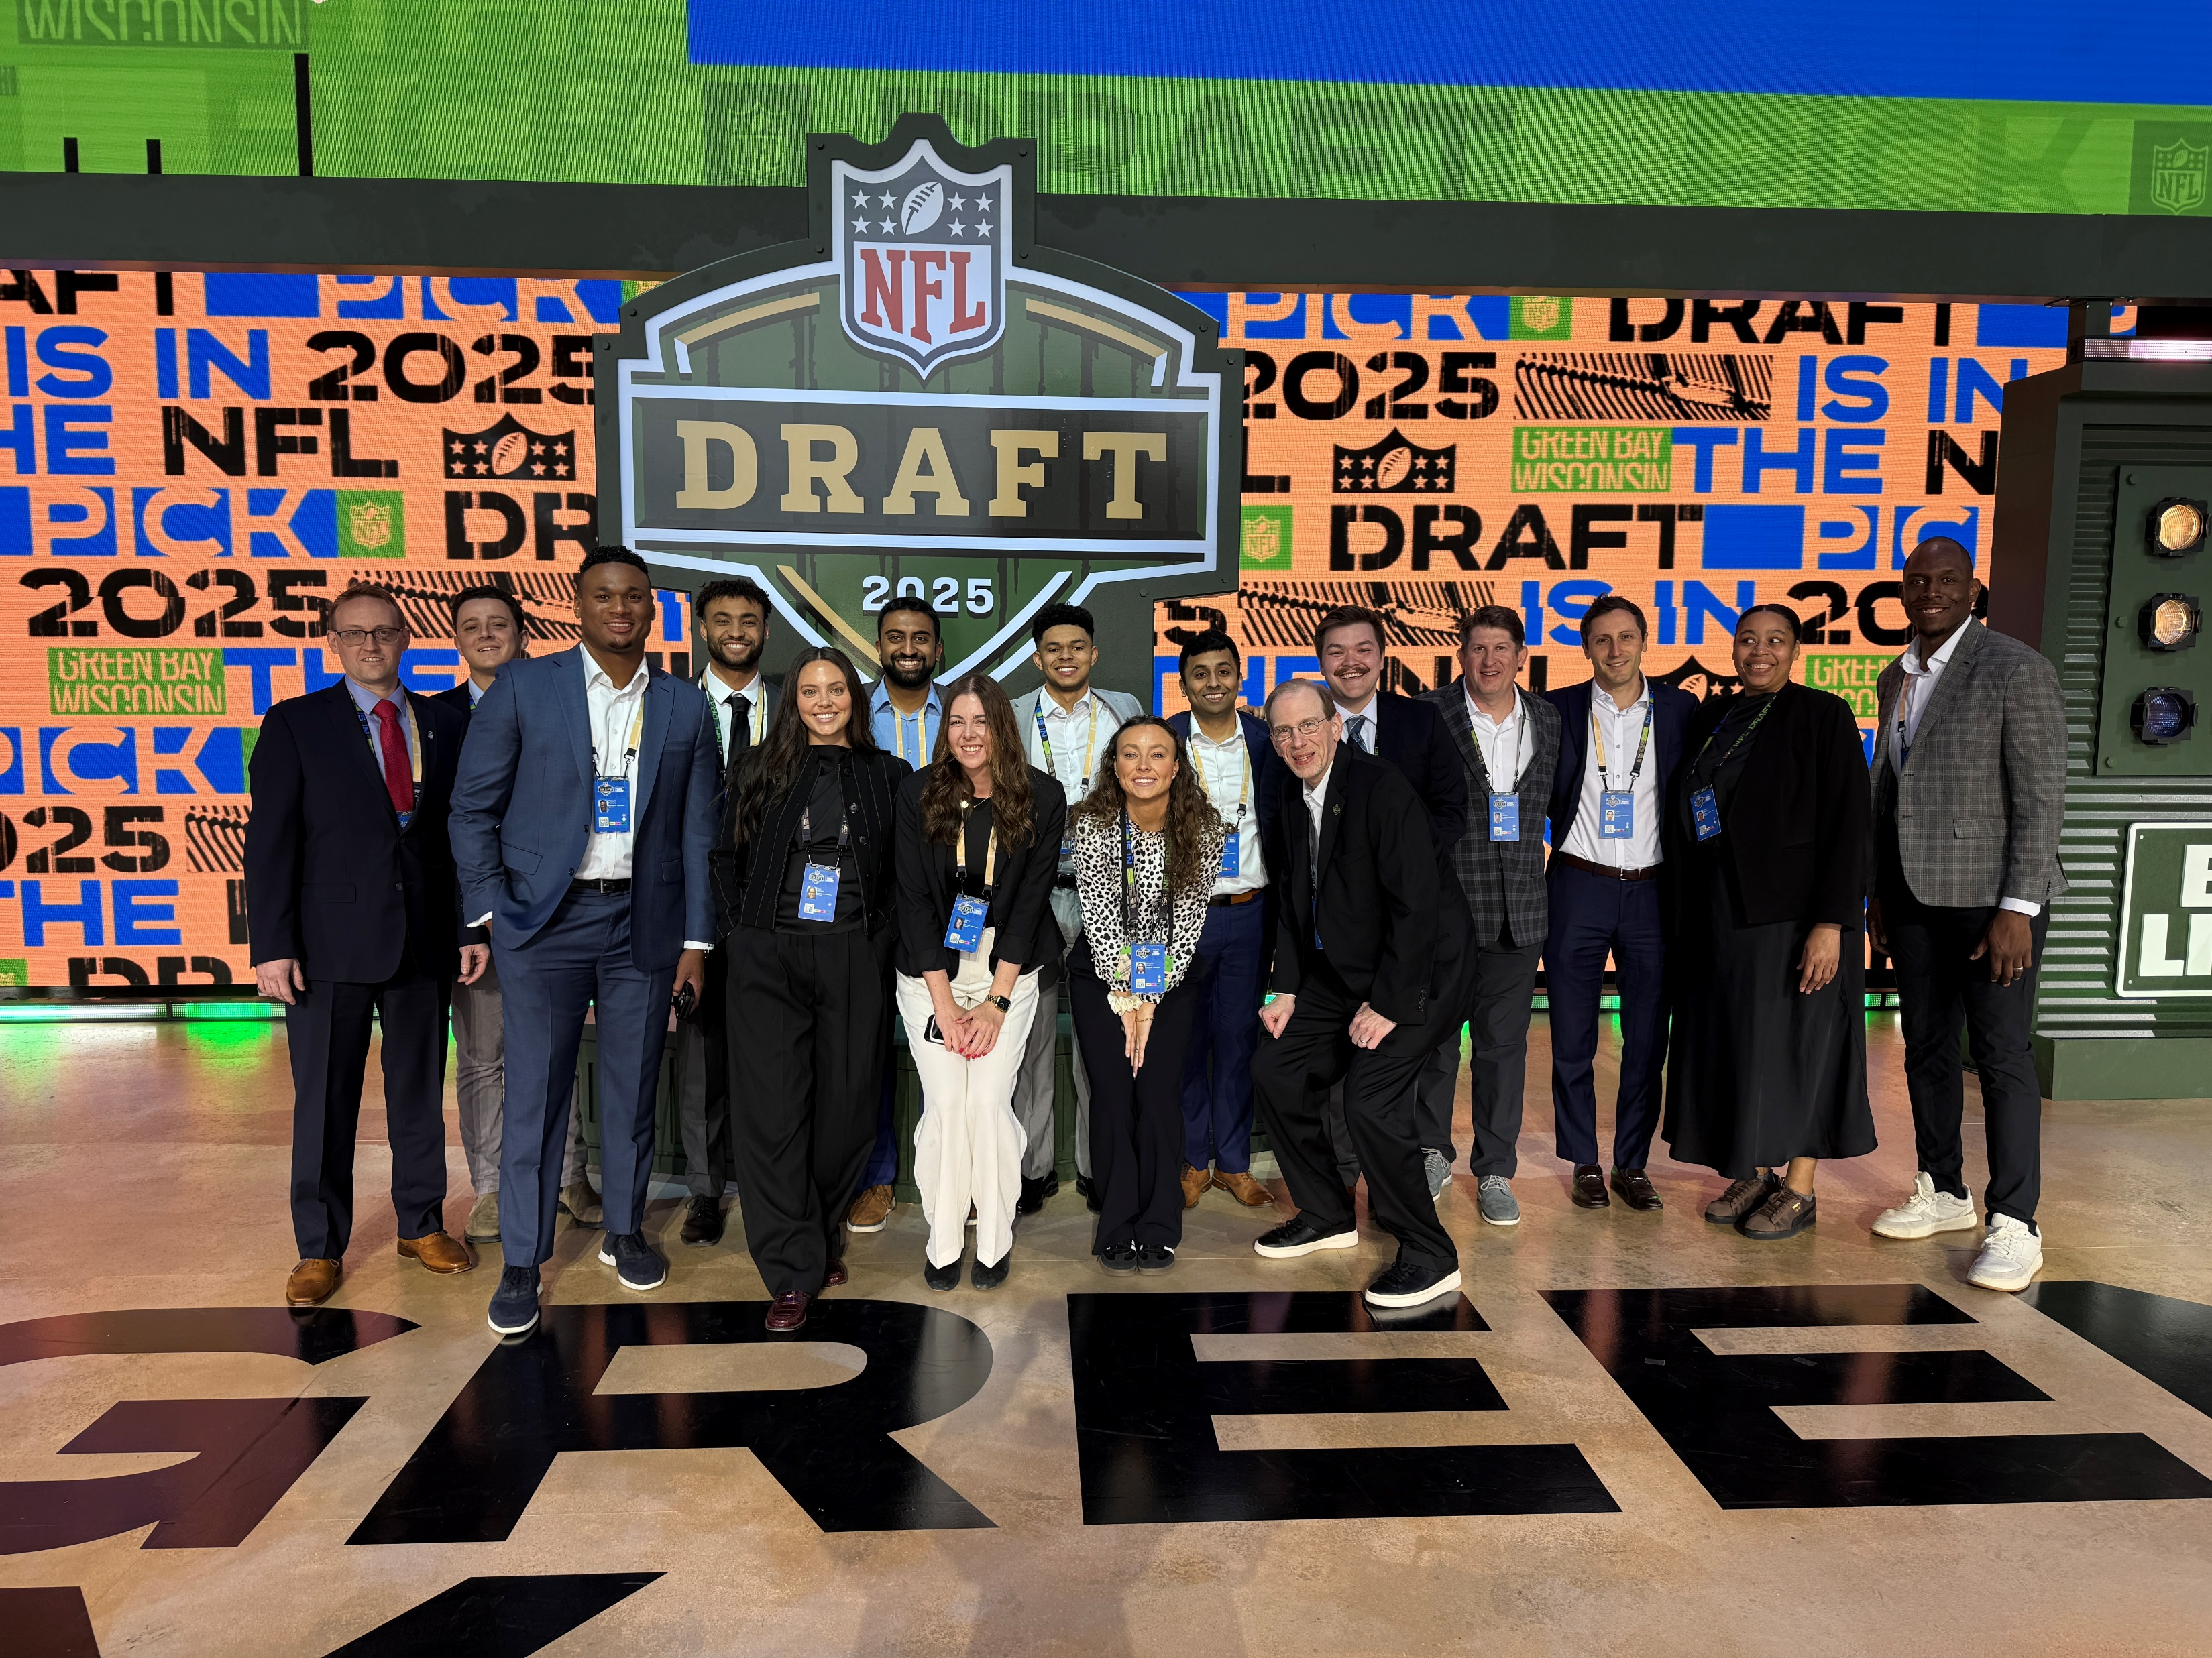
Thank You to the Best Team!

